Slide 1
DEFORMATION TRANSFER FOR TRIANGLE MESHES Correspondences
BY :
ROBERT W. SUMNER
and
JOVAN POPOVIC´
Computer Science and Artificial Intelligence Laboratory
Massachusetts Institute of Technology

Slide 2
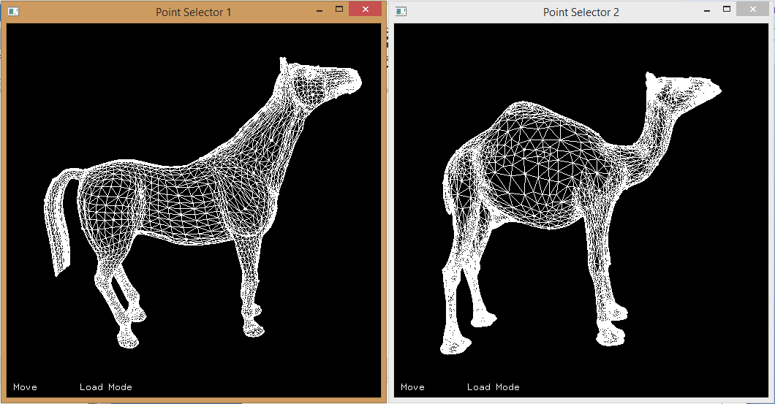

Slide 3
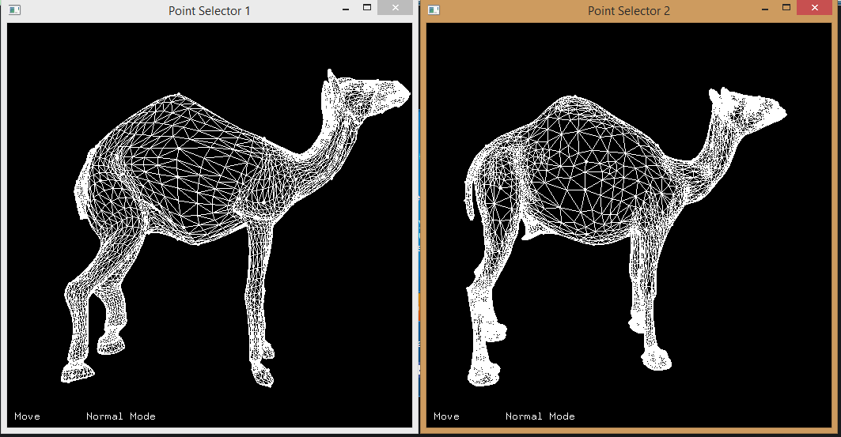

Slide 4
Deformation transfer applies the deformation exhibited by a source triangle mesh onto a different target triangle mesh
The user builds a correspondence map between the triangles of the source and those of the target by specifying a small set of vertex markers
Then we find correspondence map between triangles in source mesh and target mesh
The correspondence is used to transfer the deformation between source and target mesh

Slide 5
We compute the deformation vector as
Q = V~ V⁻¹
where V~ is the transformed vertex
And V is the original vertex
V = [v2-v1 v3-v1 v4-v1]
v4 = (v2 – v1) x (v3 –v1)/sqrt((v2 – v1) x (v3 –v1))
v4 tells us how the space perpendicular to the surface deforms

Slide 6
We have three terms to minimize here :
Smoothness term :
E_{s} = ∑_{i=1-T} ∑_{j = adj(i)} ||T_{i} – T_{j} ||²
This ensures the transformation of adjacent triangles are same

Slide 7
Deformation identity :
E_{i} = ∑_{i=1-T} ||T_{i} – I ||²
This ensures that smoothness term does not create very high changes to the overall mesh

Slide 8
Closest Valid Point:
E_{c} = ∑_{i=1-N} ||V_{i} – C_{i} ||²
We find the closest point in target mesh for each source mesh point and try to move it towards them

Slide 9
Overall minimization term :
WsEs + WiEi + WcEc
For first iteration Wc = 0
We increment Wc in next iterations

Slide 10
We then calculate the correspondence between source mesh triangle and target mesh triangles using the following criteria :
If the centroid of the source and destination triangle is less then threshold and angle between the face normal is less than 90 degree I add it to the correspondance list.
We find the closest triangle for source to target and then target to source to get the complete list

Slide 11
Questions ??
Presented By :
Rezaul

